Slide 1

SMART IRRIGATION SYSTEM
S KRITHI
S SWAYAMBH
S SANJANA

Slide 2
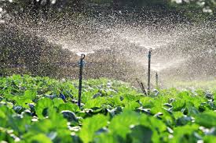
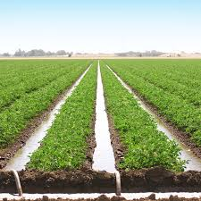
INTRODUCTION
IRRIGATION
An irrigation system is a method for applying water to land and crops, usually in agriculture, when natural rainfall is insufficient or inconsistent. These systems use pumps, tubes, and other equipment to deliver water from a source like a well or river, and can include methods such as surface, sprinkler, or drip irrigation. Their purpose is to ensure plants receive the water necessary for growth, leading to improved crop production

Slide 3
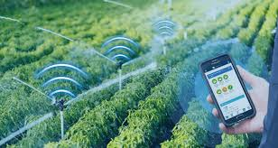
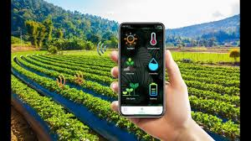
SMART IRRIGATION SYSTEM
A smart irrigation system is an automated system that optimizes water use for plants by using sensors and weather data to deliver water precisely when and where it's needed, preventing overwatering and conserving resources. These systems often incorporate soil moisture sensors, temperature sensors, weather data, and controllers to adjust watering schedules for efficiency and improved plant health.

Slide 4
PROBLEMS WITH TRADITIONAL IRRIGATION SYSTEM
Water Wastage:
Excess water is often used, leading to wastage and depletion of water resources.
Manual Monitoring:
Requires constant human supervision to turn water on/off and check soil moisture.
Uneven Water Distribution:
Some areas get overwatered while others remain dry, affecting crop growth.
High Labor Cost:
Continuous human effort increases time and cost of maintenance.
Energy Inefficiency:
Pumps and valves may run unnecessarily, consuming more power.
Soil Erosion and Nutrient Loss:
Over-irrigation can wash away topsoil and essential nutrients.
Not Climate Adaptive:
Cannot adjust automatically to changing weather conditions like rain or drought.

Slide 5
Who does it help?
Smart irrigation systems help farmers, property owners (residential and commercial), and the environment by conserving water, reducing costs, improving plant health, and boosting efficiency through data-driven, automated watering tailored to real-time needs.
Benefits of SIS
Conserve water efficiently
Reduce overall costs
Minimize environmental impact
Support sustainable water management
Useful in agriculture, landscaping ad home gardening.

Slide 6
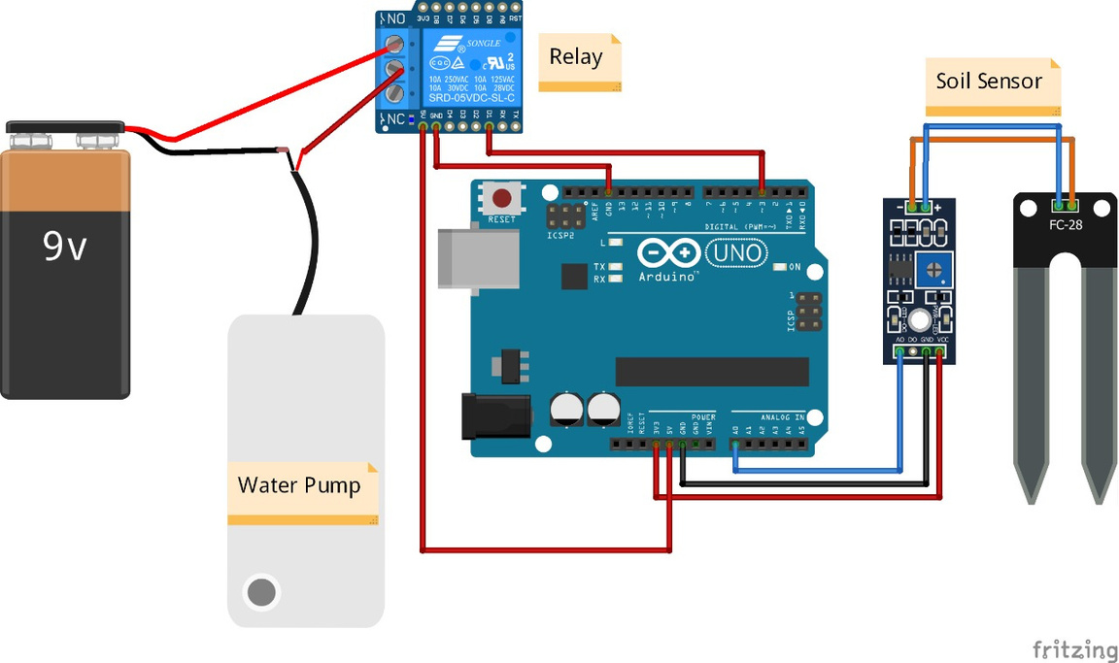

Slide 7
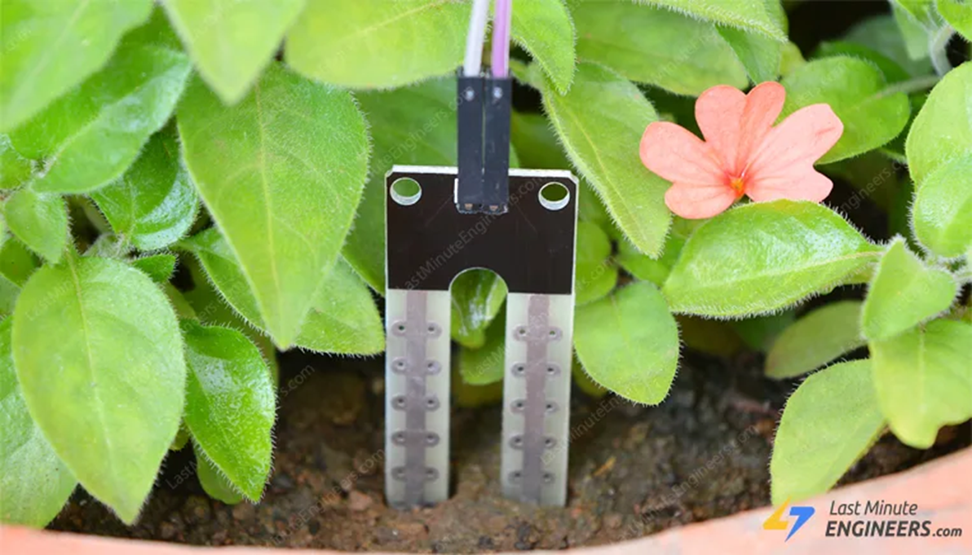
SMART MOISTURE SENSOR
Soil moisture sensors work on the principle that soil's electrical resistance or capacitance changes with its water content. A RESISTIVE SENSOR measures resistance between two probes: wet soil conducts electricity better, resulting in lower resistance, while dry soil has high resistance. CAPACITIVE SENSORS use the dielectric permittivity, which is influenced by water molecules, to measure moisture. The sensor then converts these changes into a moisture level reading.

Slide 8
OBJECTIVES OF OUR PROJECT
To design an automated irrigation system that supplies water to plants only when needed.
To conserve water by using sensors that detect soil moisture levels.
To reduce manual effort in monitoring and watering plants.
To increase crop yield and plant health through proper water management.
To promote energy efficiency by controlling pumps automatically.
To create a cost-effective and sustainable solution for farmers and gardeners.
To demonstrate the use of technology (IoT/sensors/microcontroller) in modern agriculture.

Slide 9
Future scope:
IoT Integration – The system can be connected to the Internet to monitor and control irrigation remotely using a mobile app.
Weather-Based Control – Adding weather sensors or online weather data can help adjust watering based on rainfall or humidity.
Solar Power Use – The system can be powered by solar energy for greater sustainability and use in remote areas.
Data Logging and Analysis – Storing moisture and water usage data can help study soil patterns and improve crop management.
Automatic Fertilizer Mixing – Future versions can include sensors and pumps to mix and supply fertilizers automatically.

Slide 10

THANK YOU

